Slide 1
INDIGENOUS AND WESTERN WORLD VIEWS Fostering Ethical Space in the Classroom

Slide 2
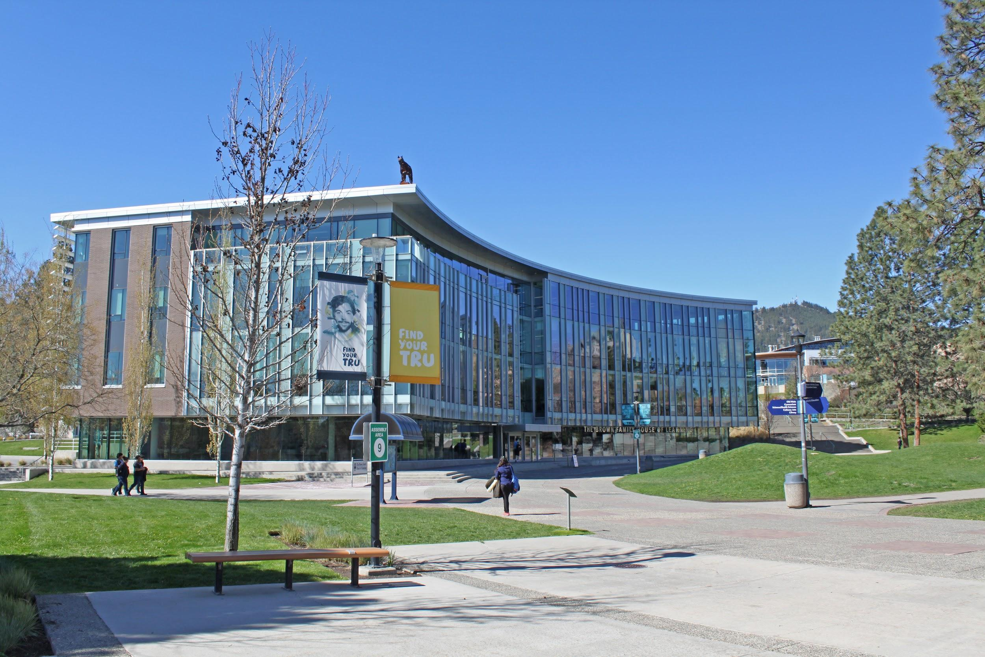
As TRU students, we want to begin by acknowledging that we are grateful to attend Thompson Rivers University on the unceded and traditional territories of the Tk'emlups te Secwepemc within Secwepemc􏰆l'ecw.

Slide 3
TABLE OF CONTENTS
SUMMARY
QUESTIONER
01
02
03
WORDSMITH
04
ACTUALIZER
Julia
Lauren
Jacob
Derek

Slide 4
SUMMARY
PART 1
PART 2
PART 3
The Western Worldview
What are Worldviews?
“A worldview is a collection of beliefs, norms, and values held by an individual or group of individuals. It is a holistic conception of the intricacies of the world; it is a lens through which one perceives and interprets life.”
The Indigenous Worldview
The importance of the circle
Interconnected Wholeness- “everything is one.”
Coexisting
HUMANS
EVERYTHING ELSE

Slide 5
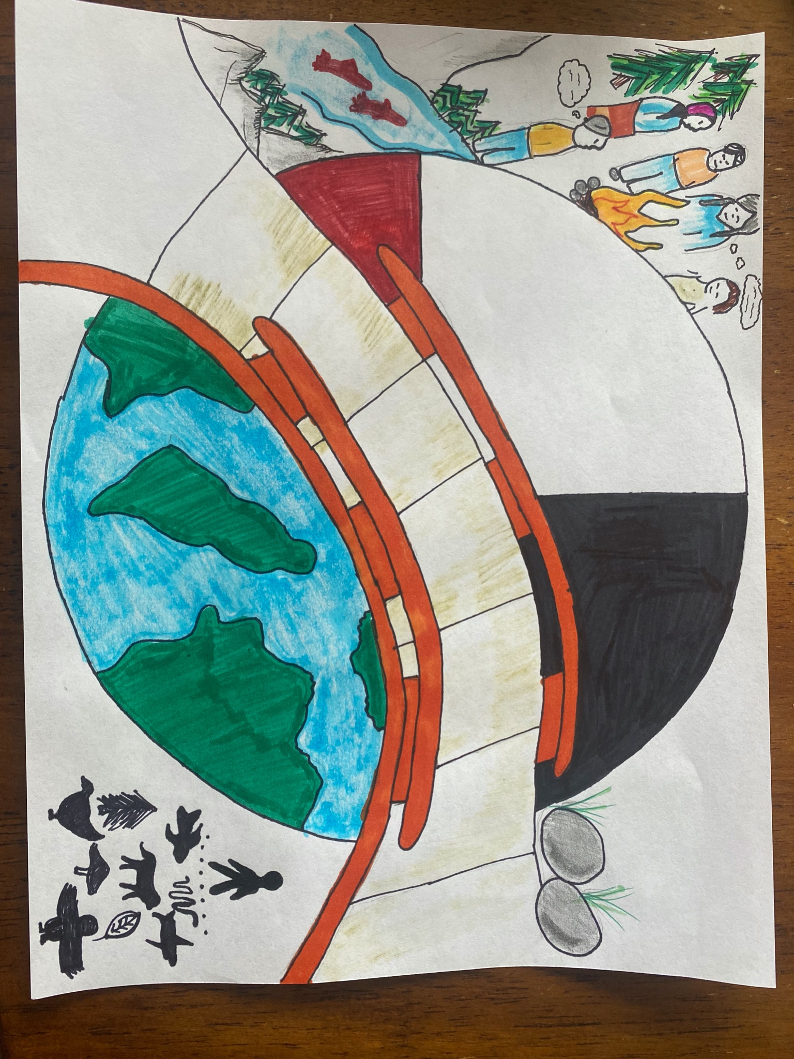

Slide 6
The Web!
Western World views
Indigenous Worldviews
Animate
Spirit
physical
The Circle
Individual
Inter-
connected Wholeness
Inanimate
Story Telling

Slide 7
Question #1
How can we create ethical space in the classroom that involve both Western and Indigenous views?
One example of creating ethical space in the classroom could be to incorporate talking circles every week. It will allow the students to share their individuality, while also creating connections and relationships with the people around them.

Slide 8
Question #2
What is one way we can connect students to Indigenous views outside of the classroom?
One way students can form a connection with Indigenous worldviews could be to take them out of the classroom and into a nature walk!

Slide 9
Purdon’s Passage Picks!
Pick #1 Page 204
Pick #2 Page 205
“The worldview under which a person functions is usually taken for granted.”
“Although there is no single Indigenous worldview but diverse worldviews, non-indigenous educators need to understand how their worldview fundamentally differs from that of Indigenous peoples before there can be true reconciliation in the classroom.”

Slide 10
Jakey the Wordsmith’s
Wonderful Words!
Worldview
Indigenous
Wechewehtowin
Collection of beliefs, norm, and values
A lens through which one perceives and interprets life
A cognitive schema
Influenced by experience, culture language, religion, gender, family, friends, etc.
United Nations Declaration on the Rights of Indigenous Peoples
The original inhabitants of a country or particular geographic territory
Woodland Cree word for “partnering”
Elmer Ghostkeeper
Traditional indigenous wisdom + western scientific knowledge

Slide 11
Activity Time!
Fasten your seatbelts folks, we’re gonna learn

Slide 12
Telling our Stories
PART ONE
-Grab a partner; someone you don’t know very well or haven’t worked with much before today. (I know you know that I know who you know)
-Sit together anywhere in the room or out in the hall, somewhere you are both comfortable.
-Take a few minutes to get to know one another; discuss such things as each person’s geographical origin, family members and their history, etc. If you don’t feel comfortable sharing these facets, learn a few interesting tidbits about one another like hobbies, favourite foods etc.

Slide 13
Telling our Stories
PART TWO
-Form a large circle in the class in which you are standing next to your partner (desks and chairs go bye bye)
-I will begin by passing an item to a member of the class and their objective is to tell the rest of the class the story of their partner!Then pass the ball on to someone new! Tell us as much as you can or as much as either partner feels comfortable with
-The focus is on strengthening interpersonal relationships

Slide 14
“an Indigenous worldview promotes the ethics of noninterference and noncompetition to foster positive interpersonal relationships and discourage physical, verbal, or psychological coercion.” -Preston, pp.210.

Slide 15
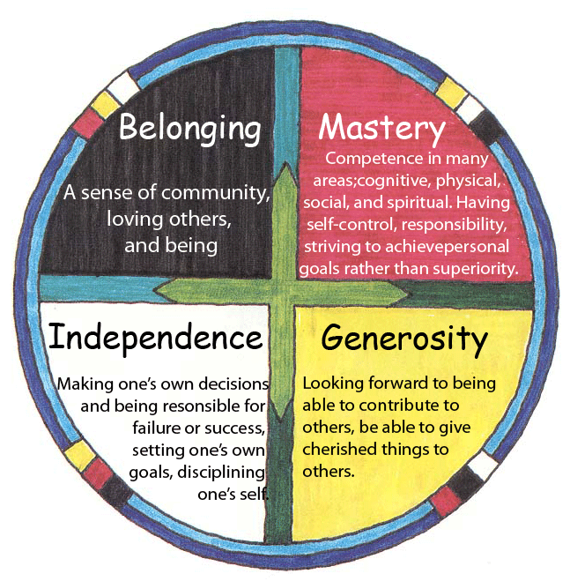
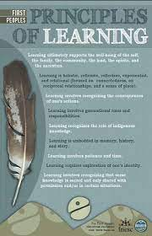

Slide 16
References
First Peoples Principles of Learning. (n.d.). First Nations Education Steering Committee. Retrieved from http://www.fnesc.ca/first-peoples-principles-of-learning/.
Government of Canada; Crown-Indigenous Relations and Northern Affairs Canada. (2016, February 24). The learning circle: Classroom activities on First Nations in Canada - ages 8 to 11. Government of Canada; Crown-Indigenous Relations and Northern Affairs Canada. Retrieved March 6, 2022, from https://www.rcaanc-cirnac.gc.ca/eng/1316530294102/1535458624988#un5
McIntyre, T. (n.d.). Circle of Courage . Retrieved March 6, 2022, from http://www.behavioradvisor.com/CircleOfCourage.html.
Preston, J. P. (2019). INDIGENOUS AND WESTERN WORLDVIEWS Fostering Ethical Space in the Classroom. Knowing the Past, Facing the Future: Indigenous Education in Canada, 204–219.

